Slide 1

RELATIVE HUMIDITY PREDICTION
A Machine Learning Project
By
Sumayyah Musa
JUNE
2019

Slide 2

OUTLINE
Introduction
Project Description
Exploratory Data Analysis
Data Pre-processing
Modelling
Evaluation
Recommendations

Slide 3

INTRODUCTION
A cotton manufacturing company who is growing her IoT capabilities provided weather data to develop a real time alerts generation system to ensure that its products are unaffected by changes in air humidity.
Use the provided data to predict when levels of RH are likely to be high.

Slide 4
PROJECT DESCRIPTION
Weather sensor readings was collected over three years.
All measurements were taken in the morning except relative_humidity_pm.
The data was used to train, compare and contrast two Machine learning models to classify the data points as either LOW or HIGH Relative Humidity.

Slide 5
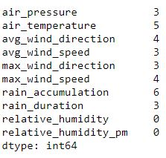
EXPLORATORY DATA ANALYSIS
Missing Values
The dataset contains 26 data points with missing values.
Feature Correlation
Avg. & Max. values for wind speed & direction
Morning and afternoon humidity

Slide 6
EXPLORATORY DATA ANALYSIS
Relative Humidity Afternoon | Count
Low | 965
High | 99
Class Imbalance
The class of interest, High RH, is under-represented.
It was taken into account during model selection and evaluation.

Slide 7
DATA PRE-PROCESSING
Missing values have been removed from the dataset
The features maximum wind speed and maximum wind direction have been removed
The target variable relative_humidity_pm has been transformed into a binary variable using a humidity threshold of 70%

Slide 8
MODELLING
Supervised Learning
The algorithm uses the sensor data about air, wind and rain to find different types of patterns.
These patterns can be used for making predictions on new sensor data.

Slide 9
MODELLING
The two classification algorithms used were Logistic Regression and Random Forests.

Slide 10
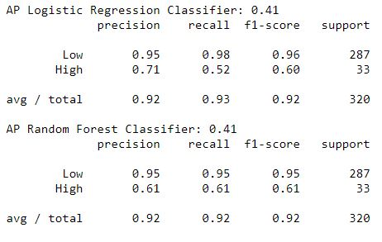
EVALUATION
Random Forest Classifier may be most suitable because the recall score of 62% outperforms the recall score of 52% of the Logistic Regression Classifier.

Slide 11
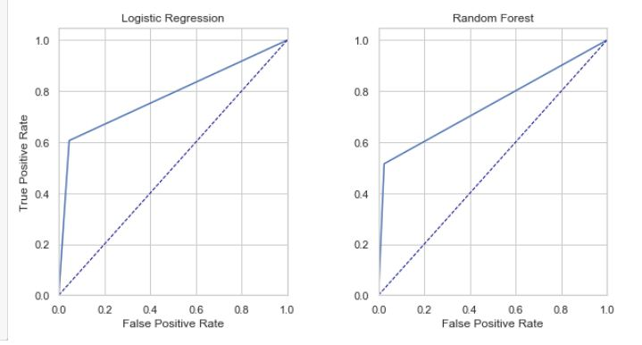
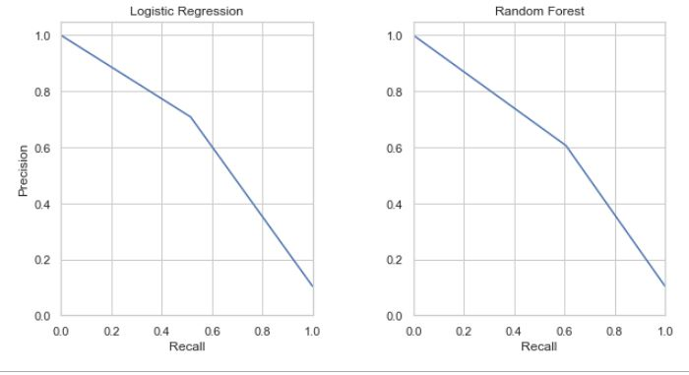
EVALUATION
ROC Curve
Precision Recall Curve

Slide 12
RECOMMENDATIONS
Search for the most suitable classification algorithm
Further develop and refine the hyper-parameter grid search of the random forest classifier
Cross validation for training each model to reduce over-fitting
The prediction model should be deployed and tested.

Slide 13

THANK YOU!
Sumayyah Musa
Phone
09099131263, 09020541877
Email
sumayyah.musa@hotmail.com

